Slide 1
Lecture 3: Market Failures: Examples and in Practice
Prof. Theising
Environmental Economics Econ 4075

Slide 2
First things first: who are our winners from last class?

Slide 3
Recap of last lecture:

Slide 4
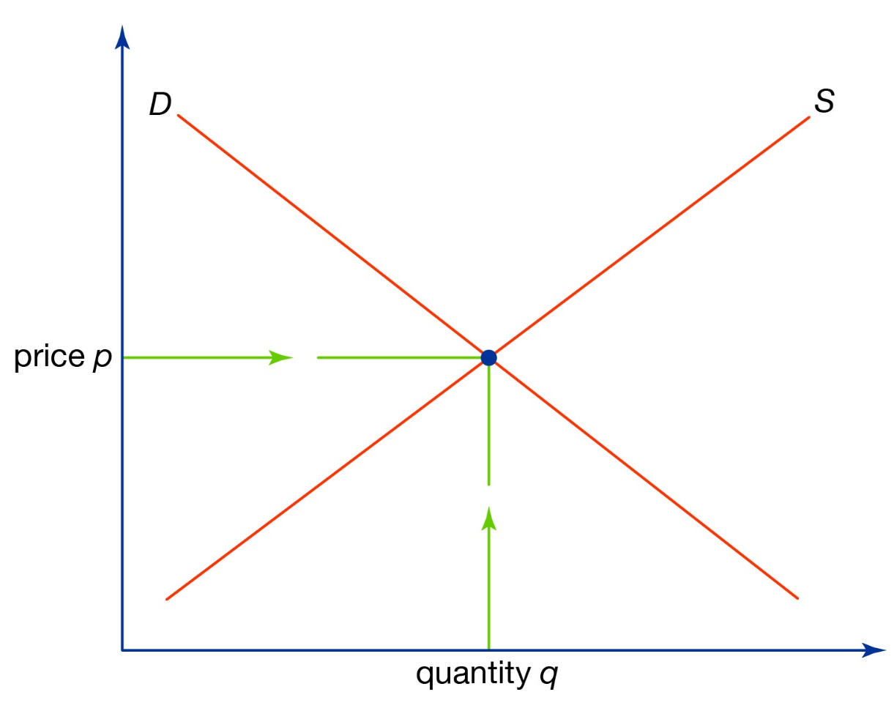
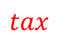


An Example: The Market for Plastic Bags
What’s missing?
The external marginal cost
Adding the external cost to the private recovers the (true) social marginal cost
The socially optimal number of bags is fewer than the private. The private market overprovides bags
What is a possible fix?
A tax equal to the external marginal cost
Value
Social
Marginal
Costs
Private
Marginal
Costs
Private
Marginal
Benefit
External
Marginal
Costs
$$tax$$
$$b_{s}^{∗}$$
$$b_{p}^{∗}$$
# of Bags

Slide 5
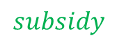


An Example: The Market for Basic Research
Basic research: scientific research largely driven by curiosity, without an immediate “real-world application” in mind.
Here: the externality is a “good”.
The private market typically underprovides basic research.
A government subsidy (often in the form of grants) can help correct this market failure
In this context, is the external marginal benefit actually fixed (flat)?
Try drawing an example of what you think external marginal benefits are
Value
Private
Marginal
Costs
Social
Marginal
Benefit
Private
Marginal
Benefit
External
Marginal
Benefit
$$subsidy$$
$$e_{s}^{∗}$$
$$e_{p}^{∗}$$
Time spent on research

Slide 6
Market Failures
There are many different types or root causes of market failures. Think of some examples under each of these categories.
Information Asymmetries
One party in a transaction knows more than the other
Market Structure/Power
One party can influence the market equilibrium
Public Goods
Nonrival and nonexcludable
Externalities
Private actions have unintended effects

Slide 7
Spot the market failure(s) in these noteworthy environmental catastrophes of recent history:

Slide 8
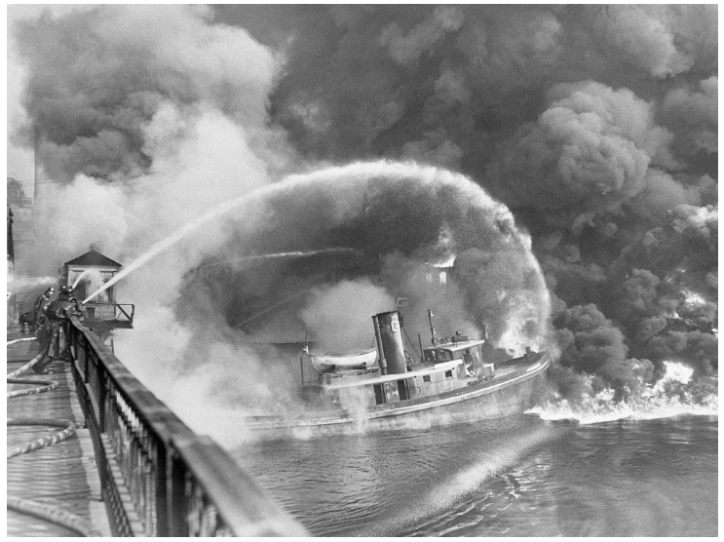
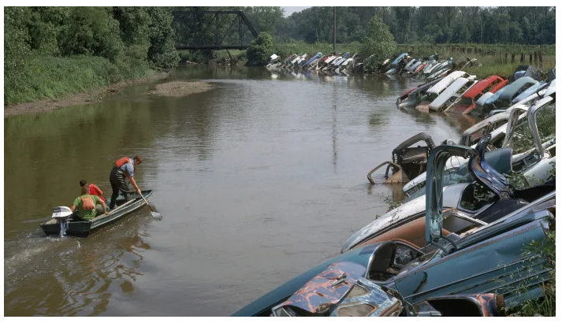
The Cuyahoga River Caught Fire at Least a Dozen Times, but No One Cared Until 1969
Source: history.com

Slide 9
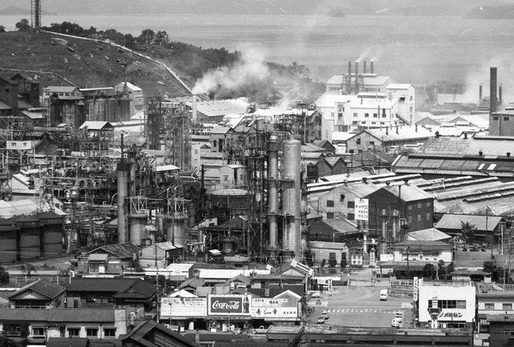

Minamata disease, 1956: the release of methylmercury in the industrial wastewater from a chemical factory owned by the Chisso Corporation
Source: Blind Magazine

Slide 10
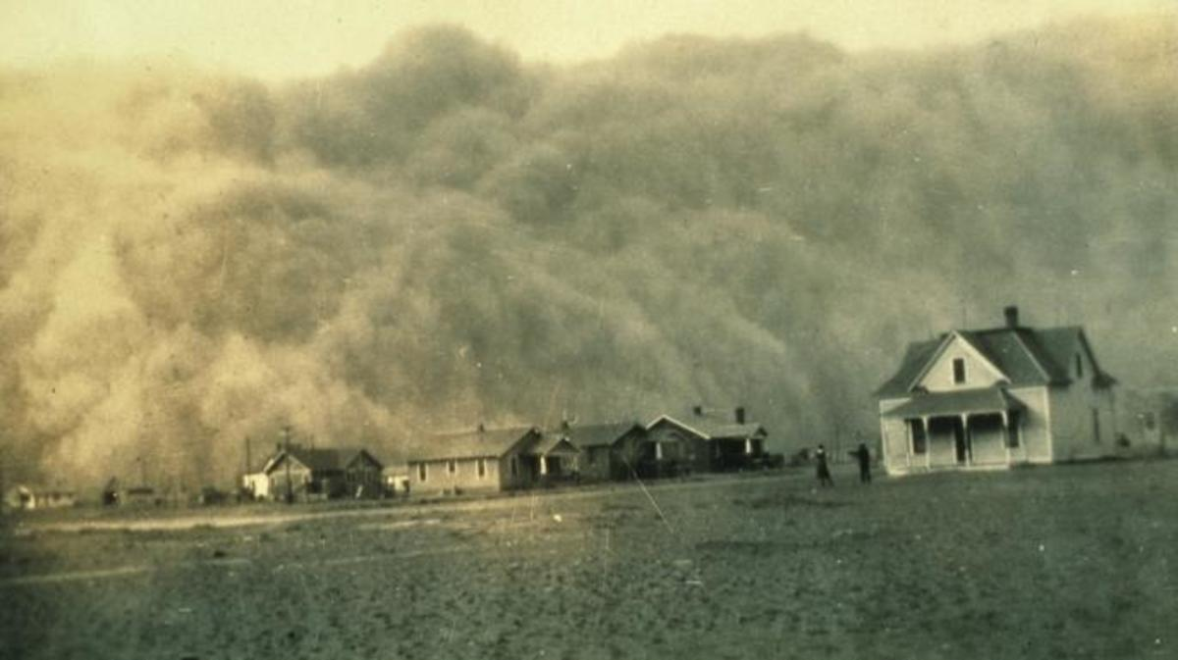

The Dust Bowl
As one “black blizzard” hit after another, harmful dust particles accumulated in people’s lungs, causing hundreds of deaths and sickening thousands.
Source: history.com

Slide 11
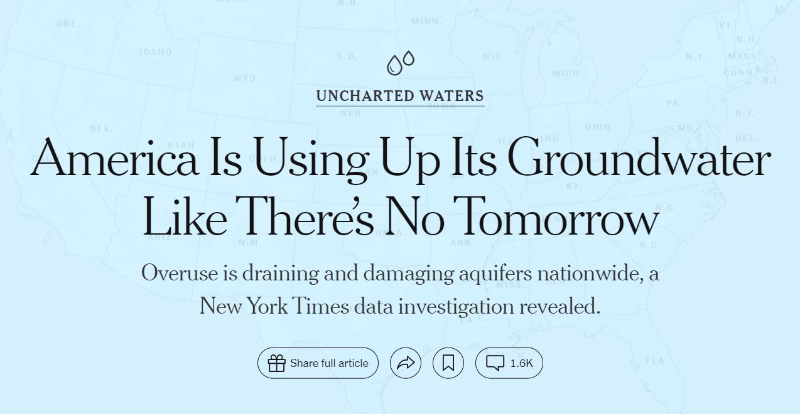
Groundwater aquifers: from the Ogallala to California to the DC suburbs… (NYT, 8/28/2023)

Slide 12
So what to do about market failures?
In the presence of public goods or positive/negative externalities, action is needed if the goal is to increase social welfare… but what?
Much of this course focuses on how governments should form policy in the presence of externalities.
We’ll come back to policy in Module 4 of this course, but let’s preview some real-world examples of an attempts to deal with externalities.

Slide 13
Good intentions, but unintended consequences: examples from economic research illustrating that incentives matter when designing a response to environmental market failures.

Slide 14
Bag Leakage: The Effect of Disposable Carryout Bag
Regulations on Unregulated Bags
By: Dr. Rebecca Taylor
Abstract: Leakage occurs when partial regulation of consumer products results in increased consumption of these products in unregulated domains. This article quantifies plastic leakage from the banning of plastic carryout bags. Using quasi-random policy variation in California, I find the elimination of 40 million pounds of plastic carryout bags is offset by a 12-million-pound increase in trash bag purchases—with small, medium, and tall trash bag sales increasing by 120%, 64%, and 6%, respectively. The results further reveal 12–22% of plastic carryout bags were reused as trash bags pre-regulation and show bag bans shift consumers towards fewer but heavier bags. With a substantial proportion of carryout bags already reused in a way that avoided the manufacture and purchase of another plastic bag, policy evaluations that ignore leakage effects overstate the regulation’s welfare gains.

Slide 15
Bag Leakage: The Effect of Disposable Carryout Bag
Regulations on Unregulated Bags
By: Dr. Rebecca Taylor
Abstract: Leakage occurs when partial regulation of consumer products results in increased consumption of these products in unregulated domains. This article quantifies plastic leakage from the banning of plastic carryout bags. Using quasi-random policy variation in California, I find the elimination of 40 million pounds of plastic carryout bags is offset by a 12-million-pound increase in trash bag purchases—with small, medium, and tall trash bag sales increasing by 120%, 64%, and 6%, respectively. The results further reveal 12–22% of plastic carryout bags were reused as trash bags pre-regulation and show bag bans shift consumers towards fewer but heavier bags. With a substantial proportion of carryout bags already reused in a way that avoided the manufacture and purchase of another plastic bag, policy evaluations that ignore leakage effects overstate the regulation’s welfare gains.

Slide 16
Bag Leakage: The Effect of Disposable Carryout Bag
Regulations on Unregulated Bags
By: Dr. Rebecca Taylor
Abstract: Leakage occurs when partial regulation of consumer products results in increased consumption of these products in unregulated domains. This article quantifies plastic leakage from the banning of plastic carryout bags. Using quasi-random policy variation in California, I find the elimination of 40 million pounds of plastic carryout bags is offset by a 12-million-pound increase in trash bag purchases—with small, medium, and tall trash bag sales increasing by 120%, 64%, and 6%, respectively. The results further reveal 12–22% of plastic carryout bags were reused as trash bags pre-regulation and show bag bans shift consumers towards fewer but heavier bags. With a substantial proportion of carryout bags already reused in a way that avoided the manufacture and purchase of another plastic bag, policy evaluations that ignore leakage effects overstate the regulation’s welfare gains.

Slide 17
Bag Leakage: The Effect of Disposable Carryout Bag
Regulations on Unregulated Bags
By: Dr. Rebecca Taylor
Abstract: Leakage occurs when partial regulation of consumer products results in increased consumption of these products in unregulated domains. This article quantifies plastic leakage from the banning of plastic carryout bags. Using quasi-random policy variation in California, I find the elimination of 40 million pounds of plastic carryout bags is offset by a 12-million-pound increase in trash bag purchases—with small, medium, and tall trash bag sales increasing by 120%, 64%, and 6%, respectively. The results further reveal 12–22% of plastic carryout bags were reused as trash bags pre-regulation and show bag bans shift consumers towards fewer but heavier bags. With a substantial proportion of carryout bags already reused in a way that avoided the manufacture and purchase of another plastic bag, policy evaluations that ignore leakage effects overstate the regulation’s welfare gains.

Slide 18
Bag Leakage: The Effect of Disposable Carryout Bag
Regulations on Unregulated Bags
By: Dr. Rebecca Taylor
Abstract: Leakage occurs when partial regulation of consumer products results in increased consumption of these products in unregulated domains. This article quantifies plastic leakage from the banning of plastic carryout bags. Using quasi-random policy variation in California, I find the elimination of 40 million pounds of plastic carryout bags is offset by a 12-million-pound increase in trash bag purchases—with small, medium, and tall trash bag sales increasing by 120%, 64%, and 6%, respectively. The results further reveal 12–22% of plastic carryout bags were reused as trash bags pre-regulation and show bag bans shift consumers towards fewer but heavier bags. With a substantial proportion of carryout bags already reused in a way that avoided the manufacture and purchase of another plastic bag, policy evaluations that ignore leakage effects overstate the regulation’s welfare gains.

Slide 19
Bag Leakage: The Effect of Disposable Carryout Bag
Regulations on Unregulated Bags
By: Dr. Rebecca Taylor
Abstract: Leakage occurs when partial regulation of consumer products results in increased consumption of these products in unregulated domains. This article quantifies plastic leakage from the banning of plastic carryout bags. Using quasi-random policy variation in California, I find the elimination of 40 million pounds of plastic carryout bags is offset by a 12-million-pound increase in trash bag purchases—with small, medium, and tall trash bag sales increasing by 120%, 64%, and 6%, respectively. The results further reveal 12–22% of plastic carryout bags were reused as trash bags pre-regulation and show bag bans shift consumers towards fewer but heavier bags. With a substantial proportion of carryout bags already reused in a way that avoided the manufacture and purchase of another plastic bag, policy evaluations that ignore leakage effects overstate the regulation’s welfare gains.

Slide 20
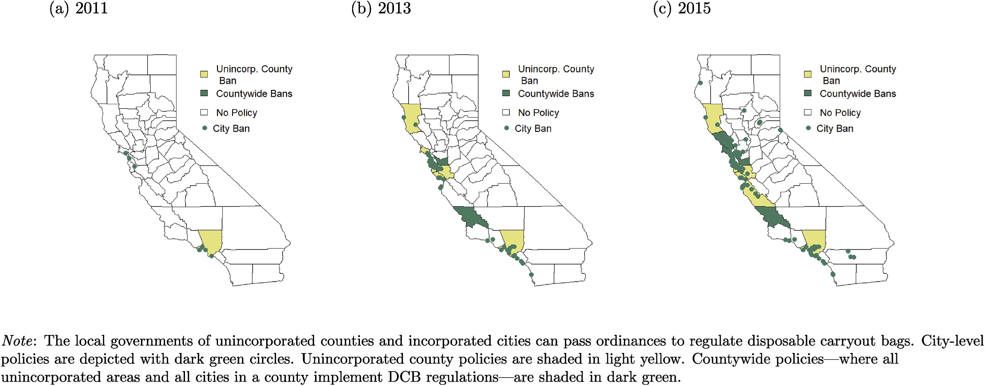
Bag Leakage: The Effect of Disposable Carryout Bag
Regulations on Unregulated Bags
By: Dr. Rebecca Taylor

Slide 21
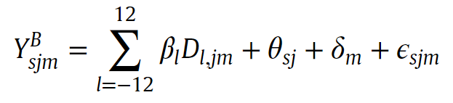
Bag Leakage: The Effect of Disposable Carryout Bag
Regulations on Unregulated Bags
By: Dr. Rebecca Taylor

Slide 22
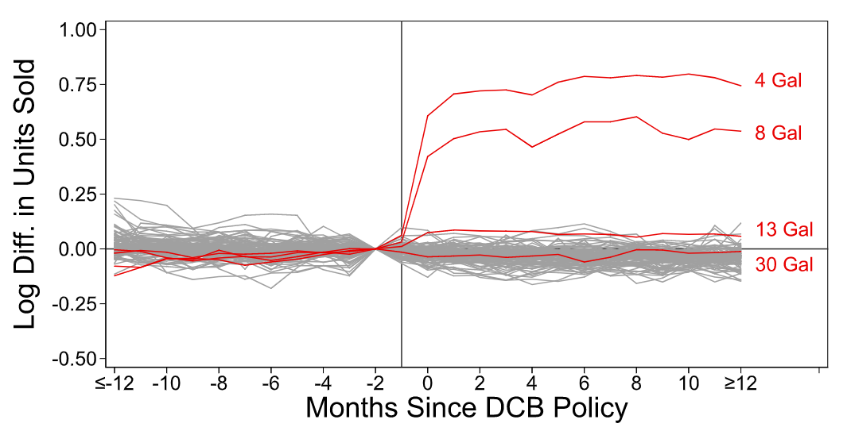

Slide 23
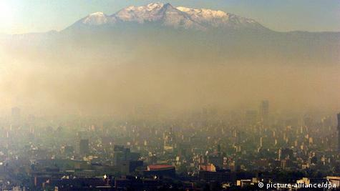
The Effect of Driving Restrictions on Air Quality in
Mexico City
By: Dr. Lucas Davis

Slide 24
The Effect of Driving Restrictions on Air Quality in
Mexico City
By: Dr. Lucas Davis
In 1989, the government of Mexico City introduced the “Hoy No Circula” (“Today Don’t Drive”, or “Day Without A Car”) policy with the specific goal of reducing air pollution.
Every vehicle, commercial and private, must stay off the roads one day of the work week (Mon-Fri, 5 AM-10PM).
The last digit of the car’s license plate determines which day a vehicle is not allowed to be driven
Vehicles with last digits 5,6 are not allowed on the road on Mondays; 7,8 for Tuesdays, etc…

Slide 25
The Effect of Driving Restrictions on Air Quality in
Mexico City
By: Dr. Lucas Davis
What do you think was the result of this policy?

Slide 26
The Effect of Driving Restrictions on Air Quality in
Mexico City
By: Dr. Lucas Davis
Abstract: In 1989, the government of Mexico City introduced a program, Hoy No Circula, that bans most drivers from using their vehicles one weekday per week on the basis of the last digit of the vehicle’s license plate. This article measures the effect of the driving restrictions on air quality using high‐frequency measures from monitoring stations. Across pollutants and specifications there is no evidence that the restrictions have improved air quality. Evidence from additional sources indicates that the restrictions led to an increase in the total number of vehicles in circulation as well as a change in composition toward high‐emissions vehicles.

Slide 27
The Effect of Driving Restrictions on Air Quality in
Mexico City
By: Dr. Lucas Davis
Abstract: In 1989, the government of Mexico City introduced a program, Hoy No Circula, that bans most drivers from using their vehicles one weekday per week on the basis of the last digit of the vehicle’s license plate. This article measures the effect of the driving restrictions on air quality using high‐frequency measures from monitoring stations. Across pollutants and specifications there is no evidence that the restrictions have improved air quality. Evidence from additional sources indicates that the restrictions led to an increase in the total number of vehicles in circulation as well as a change in composition toward high‐emissions vehicles.

Slide 29
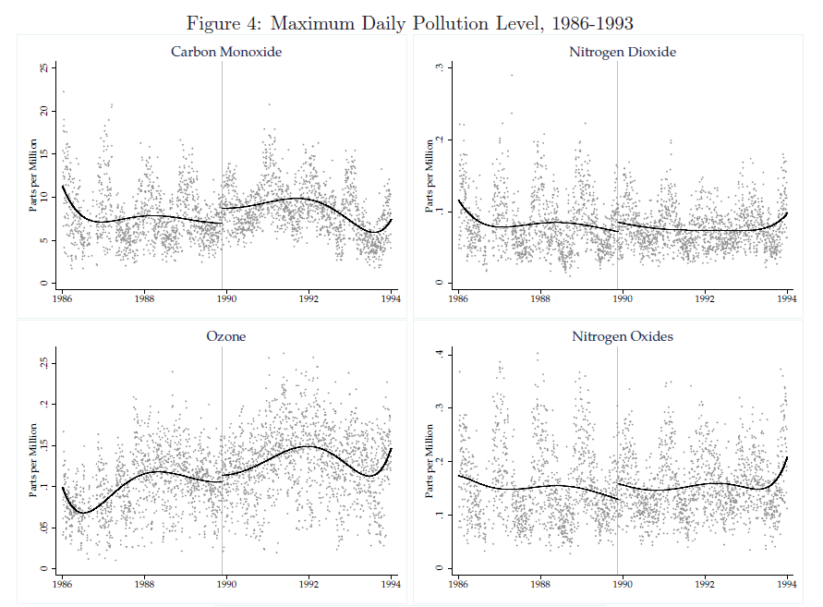

Slide 30
Downwind and out: The strategic dispersion
of power plants and their pollution
By: Dr. John Morehouse and Dr. Ed Rubin
Abstract: In federalist systems, local governments can maximize local welfare by exporting locally produced negative externalities. We empirically substantiate this externality-export strategy for air pollution using historical power-plant siting, administrative borders, and prevailing wind directions. Using a simple, non-parametric test, we show that decision-makers disproportionately sited coal-fueled plants to reduce counties’/states’ downwind pollution exposure. Natural-gas-fueled plants—lower polluters—did not follow this strategy. We then illustrate the extreme exportability of coal plants’ pollution: within 6 hours, 50% of coal plants’ emissions leave their source states—and 99% depart source counties. These results highlight how local strategic responses challenge federalist systems.

Slide 31
Downwind and out: The strategic dispersion
of power plants and their pollution
By: Dr. John Morehouse and Dr. Ed Rubin
Abstract: In federalist systems, local governments can maximize local welfare by exporting locally produced negative externalities. We empirically substantiate this externality-export strategy for air pollution using historical power-plant siting, administrative borders, and prevailing wind directions. Using a simple, non-parametric test, we show that decision-makers disproportionately sited coal-fueled plants to reduce counties’/states’ downwind pollution exposure. Natural-gas-fueled plants—lower polluters—did not follow this strategy. We then illustrate the extreme exportability of coal plants’ pollution: within 6 hours, 50% of coal plants’ emissions leave their source states—and 99% depart source counties. These results highlight how local strategic responses challenge federalist systems.

Slide 32
Downwind and out: The strategic dispersion
of power plants and their pollution
By: Dr. John Morehouse and Dr. Ed Rubin
Abstract: In federalist systems, local governments can maximize local welfare by exporting locally produced negative externalities. We empirically substantiate this externality-export strategy for air pollution using historical power-plant siting, administrative borders, and prevailing wind directions. Using a simple, non-parametric test, we show that decision-makers disproportionately sited coal-fueled plants to reduce counties’/states’ downwind pollution exposure. Natural-gas-fueled plants—lower polluters—did not follow this strategy. We then illustrate the extreme exportability of coal plants’ pollution: within 6 hours, 50% of coal plants’ emissions leave their source states—and 99% depart source counties. These results highlight how local strategic responses challenge federalist systems.

Slide 33
Downwind and out: The strategic dispersion
of power plants and their pollution
By: Dr. John Morehouse and Dr. Ed Rubin
Abstract: In federalist systems, local governments can maximize local welfare by exporting locally produced negative externalities. We empirically substantiate this externality-export strategy for air pollution using historical power-plant siting, administrative borders, and prevailing wind directions. Using a simple, non-parametric test, we show that decision-makers disproportionately sited coal-fueled plants to reduce counties’/states’ downwind pollution exposure. Natural-gas-fueled plants—lower polluters—did not follow this strategy. We then illustrate the extreme exportability of coal plants’ pollution: within 6 hours, 50% of coal plants’ emissions leave their source states—and 99% depart source counties. These results highlight how local strategic responses challenge federalist systems.

Slide 34
Downwind and out: The strategic dispersion
of power plants and their pollution
By: Dr. John Morehouse and Dr. Ed Rubin
Abstract: In federalist systems, local governments can maximize local welfare by exporting locally produced negative externalities. We empirically substantiate this externality-export strategy for air pollution using historical power-plant siting, administrative borders, and prevailing wind directions. Using a simple, non-parametric test, we show that decision-makers disproportionately sited coal-fueled plants to reduce counties’/states’ downwind pollution exposure. Natural-gas-fueled plants—lower polluters—did not follow this strategy. We then illustrate the extreme exportability of coal plants’ pollution: within 6 hours, 50% of coal plants’ emissions leave their source states—and 99% depart source counties. These results highlight how local strategic responses challenge federalist systems.

Slide 35
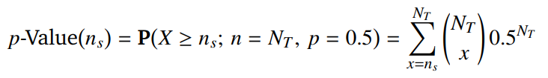
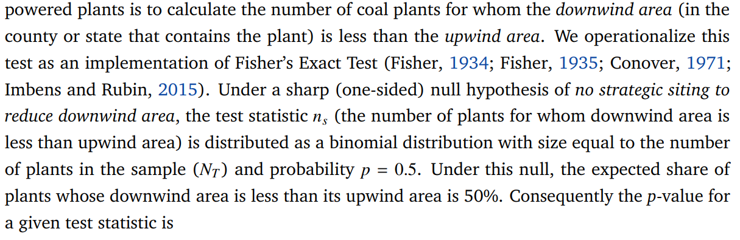
Downwind and out: The strategic dispersion
of power plants and their pollution
By: Dr. John Morehouse and Dr. Ed Rubin

Slide 36
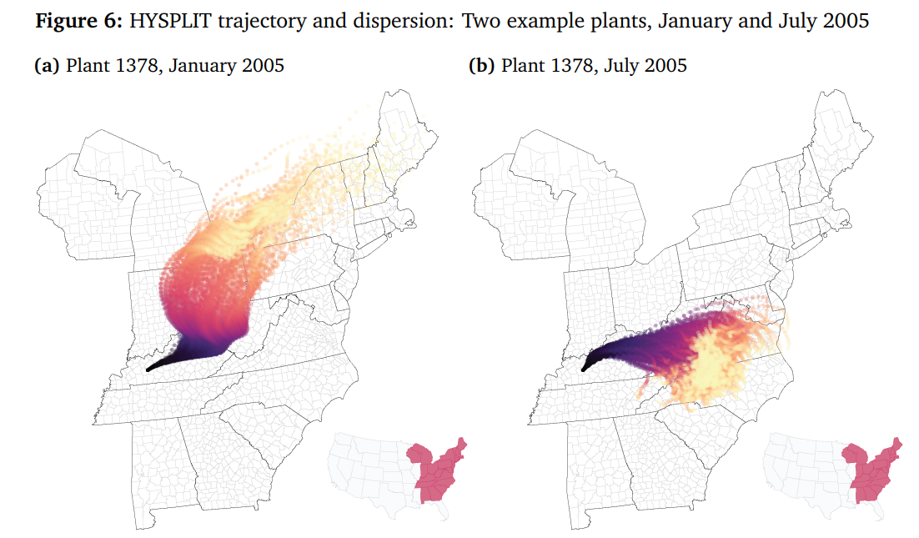
Downwind and out: The strategic dispersion
of power plants and their pollution
By: Dr. John Morehouse and Dr. Ed Rubin

Slide 37
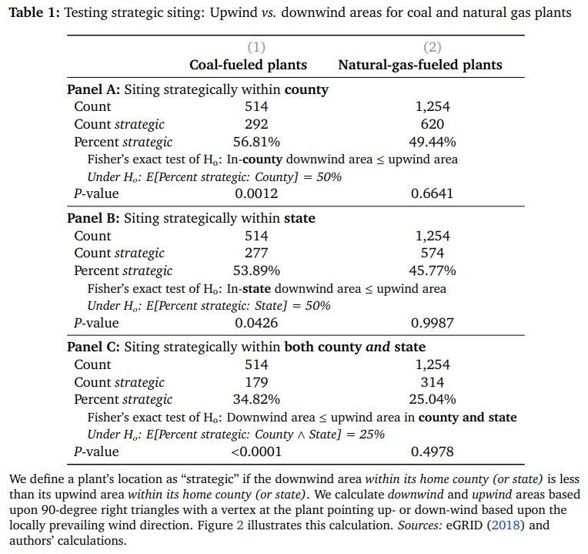

Slide 40
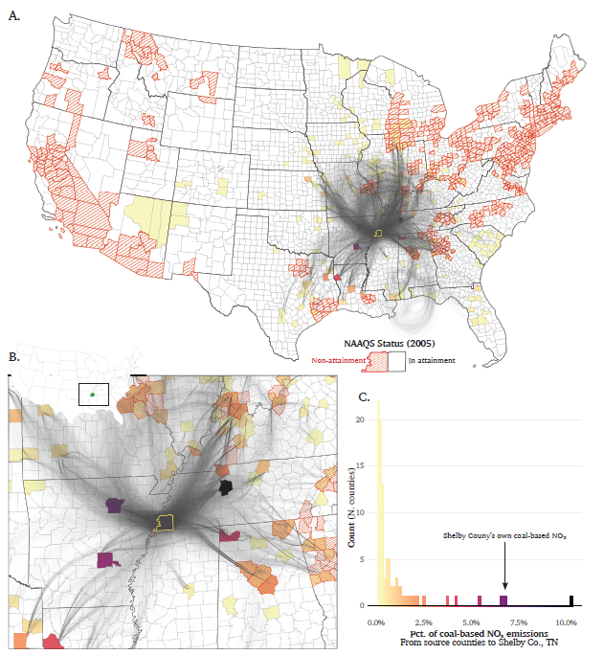

Slide 41
Learning by Viewing? Social Learning, Regulatory
Disclosure, and Firm Productivity in Shale Gas
By: T. Robert Fetter, Andrew Steck, Chris Timmins, Douglas Wrenn
“Sunlight is said to be the best of disinfectants.” – US Supreme Court Justice L. Brandeis, 1914
Environmental regulators often mandate information disclosure to reduce externalities or socially undesirable behavior
In the last 10-15 years, hydraulic fracturing for shale gas has become common in the US
Each of the 18 states with active fracking passed chemical information disclosure laws by 2015
Public concern about potential use of toxic chemicals in proximity to residential and commercial land uses
Public access to more information is generally a good thing, but this paper asks: does it come with an unintended cost?

Slide 42
Learning by Viewing? Social Learning, Regulatory
Disclosure, and Firm Productivity in Shale Gas
By: T. Robert Fetter, Andrew Steck, Chris Timmins, Douglas Wrenn
Abstract: In many industries firms can learn about new technologies from other adopters; mandatory disclosure regulations represent an understudied channel for this type of social learning. We study an environmentally-focused law in the shale gas industry to examine firm claims that disclosure requirements expose valuable trade secrets. Our research design takes advantage of a unique regulatory history that allows us to observe complete information on chemical inputs prior to disclosure, along with the timing of information availability for thousands of wells after disclosure takes effect. We find that firms’ chemical choices following disclosure converge in a manner consistent with inter-firm imitation and that this leads to more productive wells for firms that carefully choose whom to copy — but also a decline in innovation among the most productive firms, whose innovations are those most often copied by other firms. Our results suggest there is a long-run welfare trade-off between the potential benefits of information diffusion and transparency, and the potential costs of reduced innovation.

Slide 43
Learning by Viewing? Social Learning, Regulatory
Disclosure, and Firm Productivity in Shale Gas
By: T. Robert Fetter, Andrew Steck, Chris Timmins, Douglas Wrenn
Abstract: In many industries firms can learn about new technologies from other adopters; mandatory disclosure regulations represent an understudied channel for this type of social learning. We study an environmentally-focused law in the shale gas industry to examine firm claims that disclosure requirements expose valuable trade secrets. Our research design takes advantage of a unique regulatory history that allows us to observe complete information on chemical inputs prior to disclosure, along with the timing of information availability for thousands of wells after disclosure takes effect. We find that firms’ chemical choices following disclosure converge in a manner consistent with inter-firm imitation and that this leads to more productive wells for firms that carefully choose whom to copy — but also a decline in innovation among the most productive firms, whose innovations are those most often copied by other firms. Our results suggest there is a long-run welfare trade-off between the potential benefits of information diffusion and transparency, and the potential costs of reduced innovation.

Slide 44
Learning by Viewing? Social Learning, Regulatory
Disclosure, and Firm Productivity in Shale Gas
By: T. Robert Fetter, Andrew Steck, Chris Timmins, Douglas Wrenn
Abstract: In many industries firms can learn about new technologies from other adopters; mandatory disclosure regulations represent an understudied channel for this type of social learning. We study an environmentally-focused law in the shale gas industry to examine firm claims that disclosure requirements expose valuable trade secrets. Our research design takes advantage of a unique regulatory history that allows us to observe complete information on chemical inputs prior to disclosure, along with the timing of information availability for thousands of wells after disclosure takes effect. We find that firms’ chemical choices following disclosure converge in a manner consistent with inter-firm imitation and that this leads to more productive wells for firms that carefully choose whom to copy — but also a decline in innovation among the most productive firms, whose innovations are those most often copied by other firms. Our results suggest there is a long-run welfare trade-off between the potential benefits of information diffusion and transparency, and the potential costs of reduced innovation.

Slide 45
Learning by Viewing? Social Learning, Regulatory
Disclosure, and Firm Productivity in Shale Gas
By: T. Robert Fetter, Andrew Steck, Chris Timmins, Douglas Wrenn
Abstract: In many industries firms can learn about new technologies from other adopters; mandatory disclosure regulations represent an understudied channel for this type of social learning. We study an environmentally-focused law in the shale gas industry to examine firm claims that disclosure requirements expose valuable trade secrets. Our research design takes advantage of a unique regulatory history that allows us to observe complete information on chemical inputs prior to disclosure, along with the timing of information availability for thousands of wells after disclosure takes effect. We find that firms’ chemical choices following disclosure converge in a manner consistent with inter-firm imitation and that this leads to more productive wells for firms that carefully choose whom to copy — but also a decline in innovation among the most productive firms, whose innovations are those most often copied by other firms. Our results suggest there is a long-run welfare trade-off between the potential benefits of information diffusion and transparency, and the potential costs of reduced innovation.

Slide 46
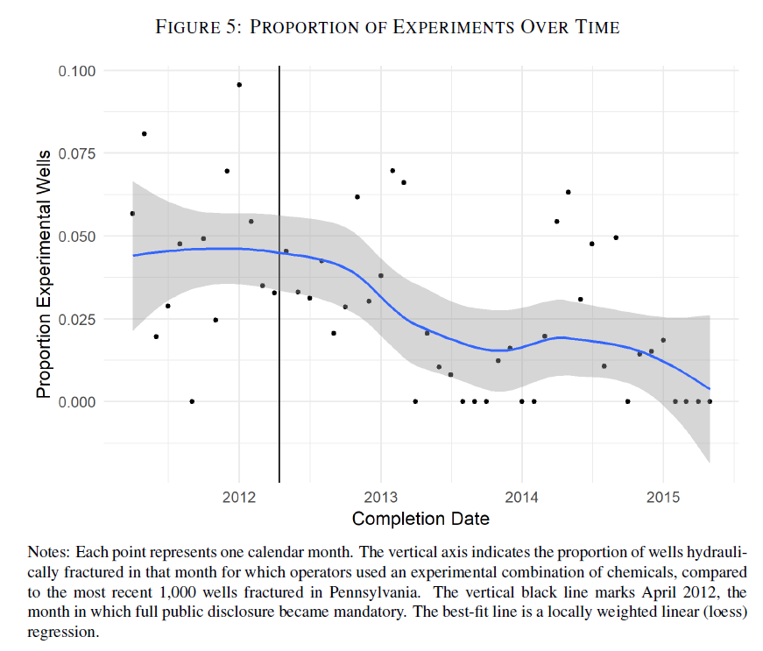

Slide 47
Learning by Viewing? Social Learning, Regulatory
Disclosure, and Firm Productivity in Shale Gas
By: T. Robert Fetter, Andrew Steck, Chris Timmins, Douglas Wrenn
Abstract: In many industries firms can learn about new technologies from other adopters; mandatory disclosure regulations represent an understudied channel for this type of social learning. We study an environmentally-focused law in the shale gas industry to examine firm claims that disclosure requirements expose valuable trade secrets. Our research design takes advantage of a unique regulatory history that allows us to observe complete information on chemical inputs prior to disclosure, along with the timing of information availability for thousands of wells after disclosure takes effect. We find that firms’ chemical choices following disclosure converge in a manner consistent with inter-firm imitation and that this leads to more productive wells for firms that carefully choose whom to copy — but also a decline in innovation among the most productive firms, whose innovations are those most often copied by other firms. Our results suggest there is a long-run welfare trade-off between the potential benefits of information diffusion and transparency, and the potential costs of reduced innovation.

Slide 48
Big-picture takeaways:
Correcting externality-driven market failures requires governmental or institutional entities to take action
But some actions may worsen the problem. Incentives and trade-offs across policy goals matter!
Effective policy considers behavioral responses and takes advantage of incentive structures.
Keep these ideas in the back of your mind as we discuss benefit and cost estimation over the next modules.

Slide 49
Next Week
Tuesday, Sept 5th is on a “Monday” Schedule
Beginning Module 2 with a lecture on econometrics and treatment effects in environmental economics
Wednesday, Sept 6th is a regularly scheduled class
Sunday, Sept 10th (@11:59pm): first reflection post is due
Reflection prompts on Github
Submission on Canvas

